Slide 1
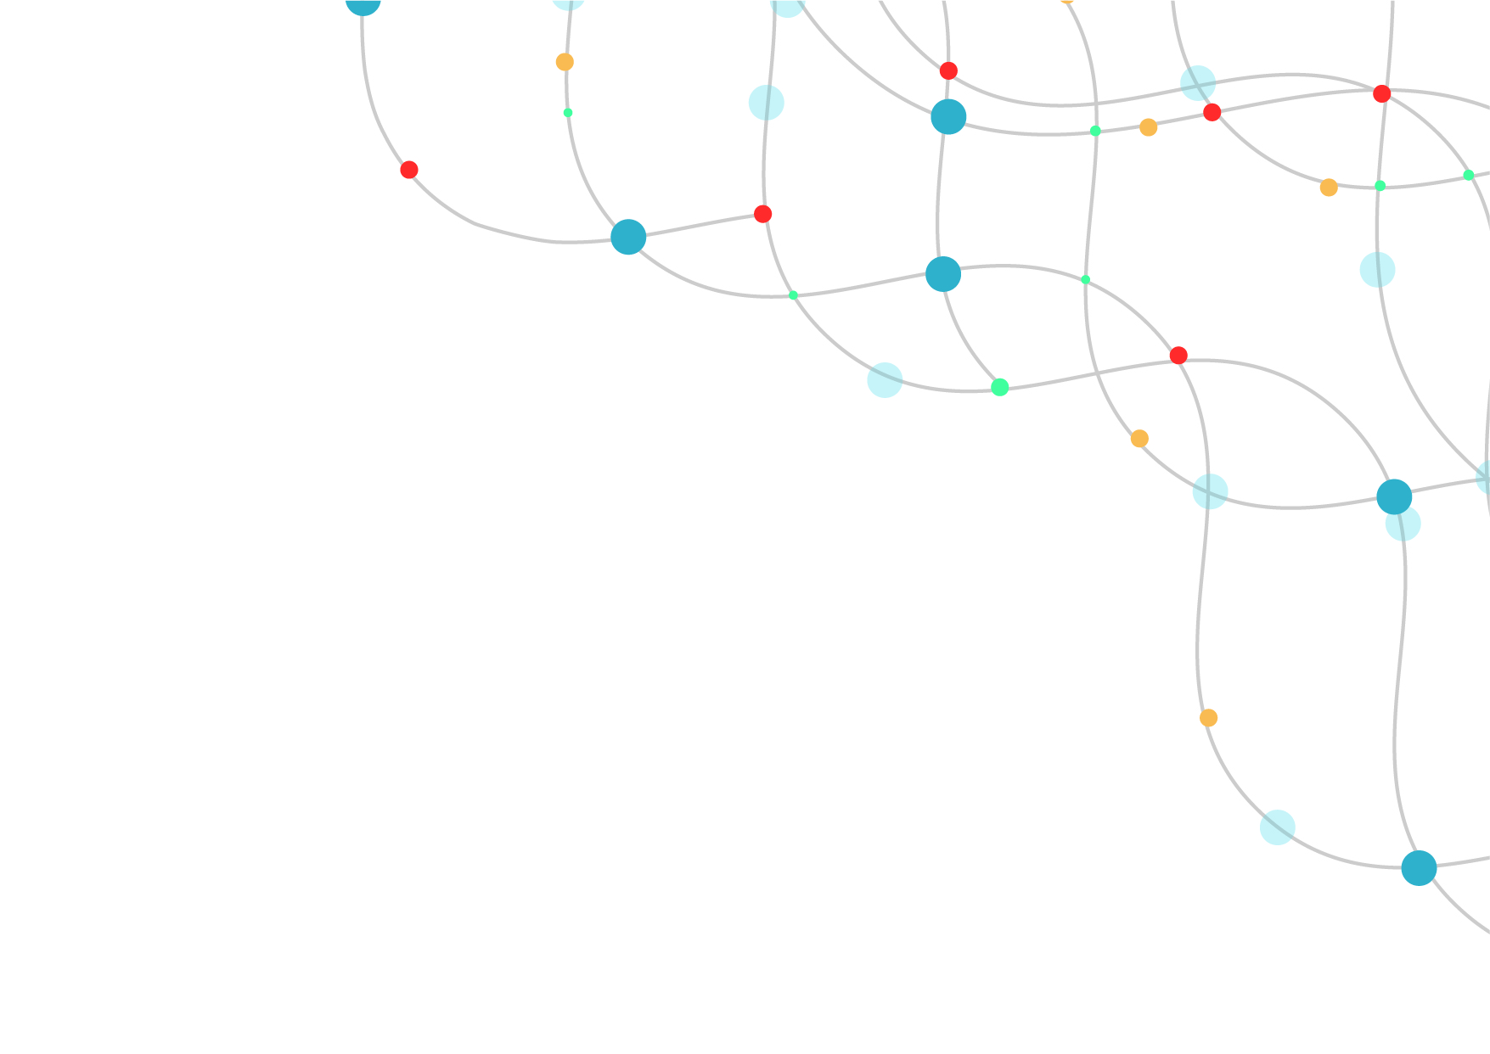
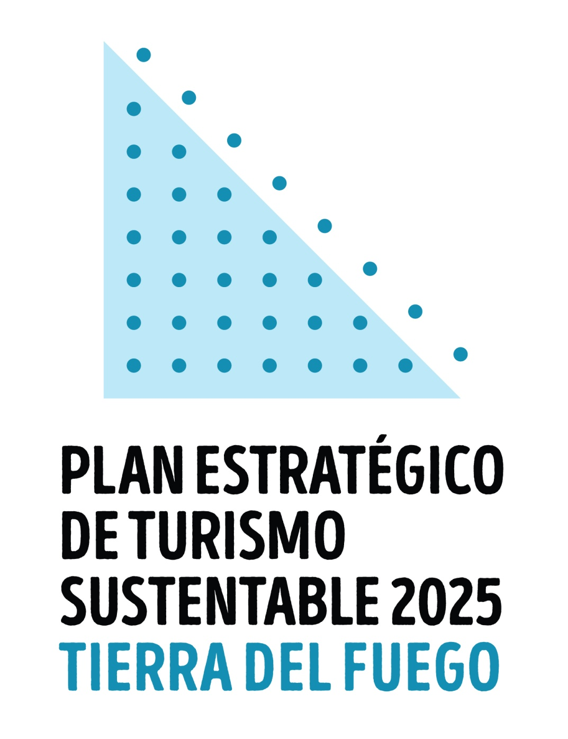





Slide 2


DMO
Destination
Management Organization
Government agency

Slide 3
TIERRA DEL FUEGO
SUSTAINABLE TOURISM STRATEGIC PLAN 2025

Slide 4

Agenda
I. The challenges
II. The strategy
III. The approach
IV. The outcome

Slide 5


I. The challenges
1. To update the existing Plan
2. Covid-19 touristic outlook
3. Available statistics
4. The SDG

Slide 6

I. The challenges
5. The DMO image
6. Brand identity

Slide 7
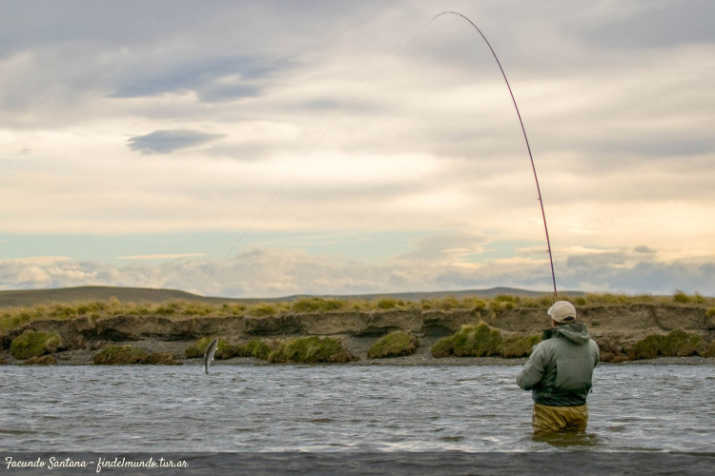
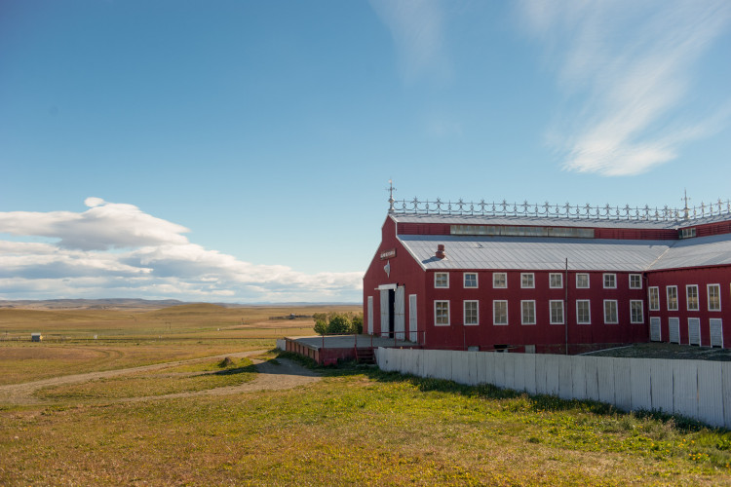
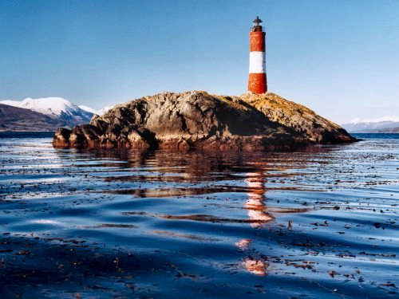
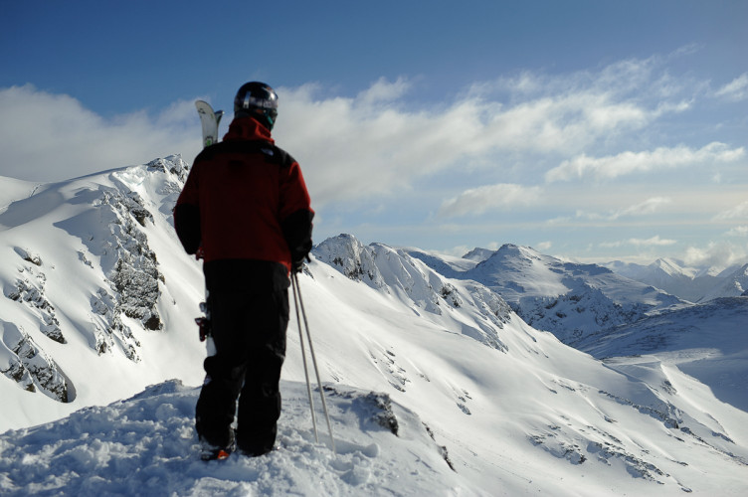
I. The challenges
6. Tourism destinations identity/brand
RIO
GRANDE
USHUAIA

Slide 8
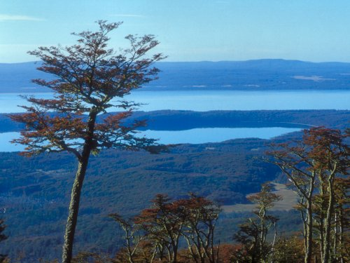
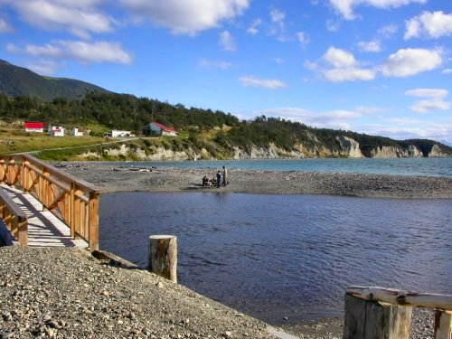
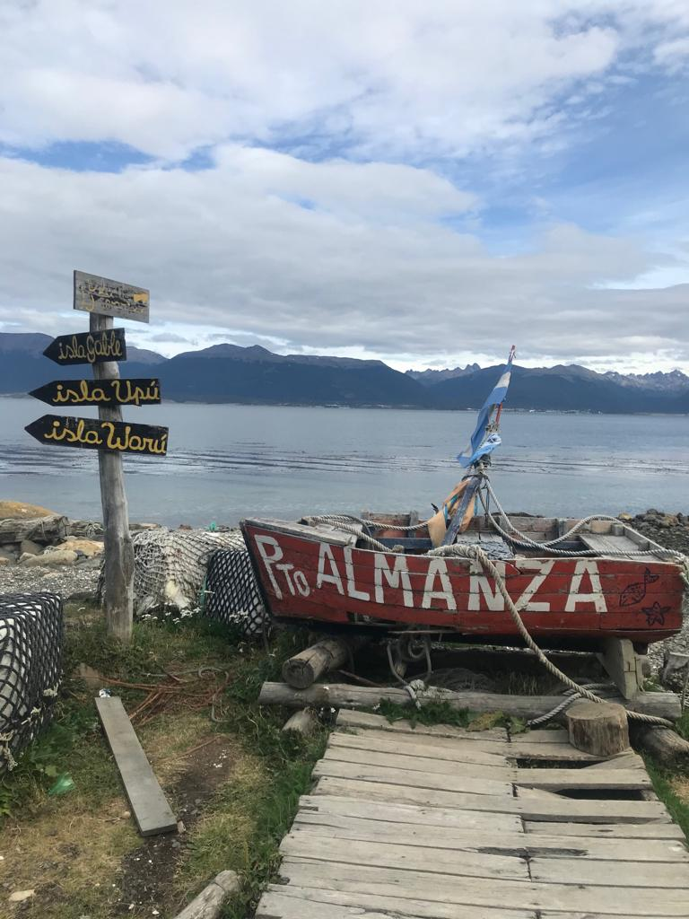
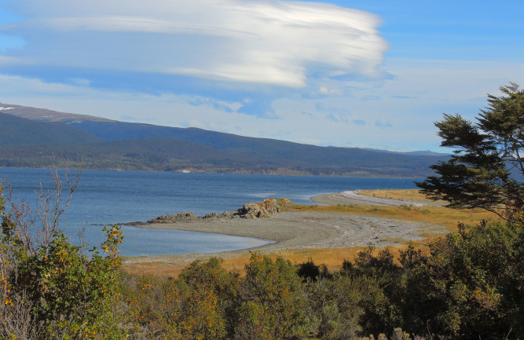
I. The challenges
6. Tourism destinations identity/brand
Tolhuin
Pto. Almanza

Slide 9
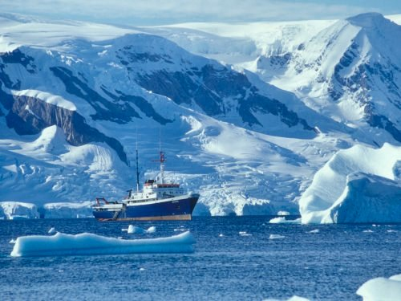
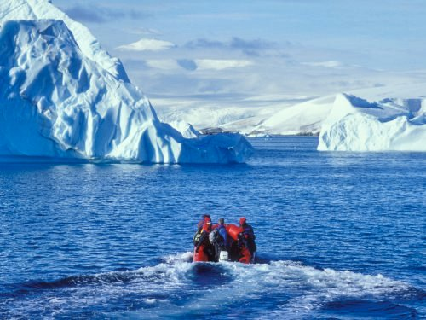
I. The challenges
7. To include Antarctic Tourism in the Plan

Slide 10
I. The challenges
7. To include Antarctic Tourism in the Plan
Our role as gateway
To improve service quality at port (waste mgmt., food supply, health services, consular assistance)
To improve specialization & standards in local production to supply ships
The need of the Antarctic Visitor Center
The role of Tierra del Fuego as a complementary destination of Antarctica
To change the perception of Argentina’s role in Antarctic tourism and share the story

Slide 11

II. The strategy
A NEW STRATEGIC APPROACH
Strategic management
Community involvement
Integrated planning & implementation
Stakeholder collaboration
Sustainable tourism & SDG

Slide 12
II. The strategy
OVERALL GOALS
To provide quality visitor experience
To be sustainable, inclusive, and compliant with the needs of the community, the environment and the economy
Considering tourism as core industry to the economy.
A NEW STRATEGIC APPROACH
Strategic management
Community involvement
Integrated planning & implementation
Stakeholder collaboration
Sustainable tourism & SDG

Slide 13
OVERALL GOALS
To provide quality visitor experience
To be sustainable, inclusive, and compliant with the needs of the community, the environment and the economy
Considering tourism as core industry to the economy.
II. The strategy
A NEW STRATEGIC APPROACH
KEY ASPECTS
Identity
Innovation
Integration
Intelligence
Strategic management
Community involvement
Integrated planning & implementation
Stakeholder collaboration
Sustainable tourism & SDG

Slide 14

The plan development phases
III. The approach
Phase 1
Background research
Phase 2
PROPOSAL
Phase 3
VALIDATION
Former Plan assessment
DMO management assessment
Stakeholder engagement
Destination audits
WORKSHOPS
SWOT analysis
Destination audits
WORKSHOPS
Updated PLAN

Slide 15
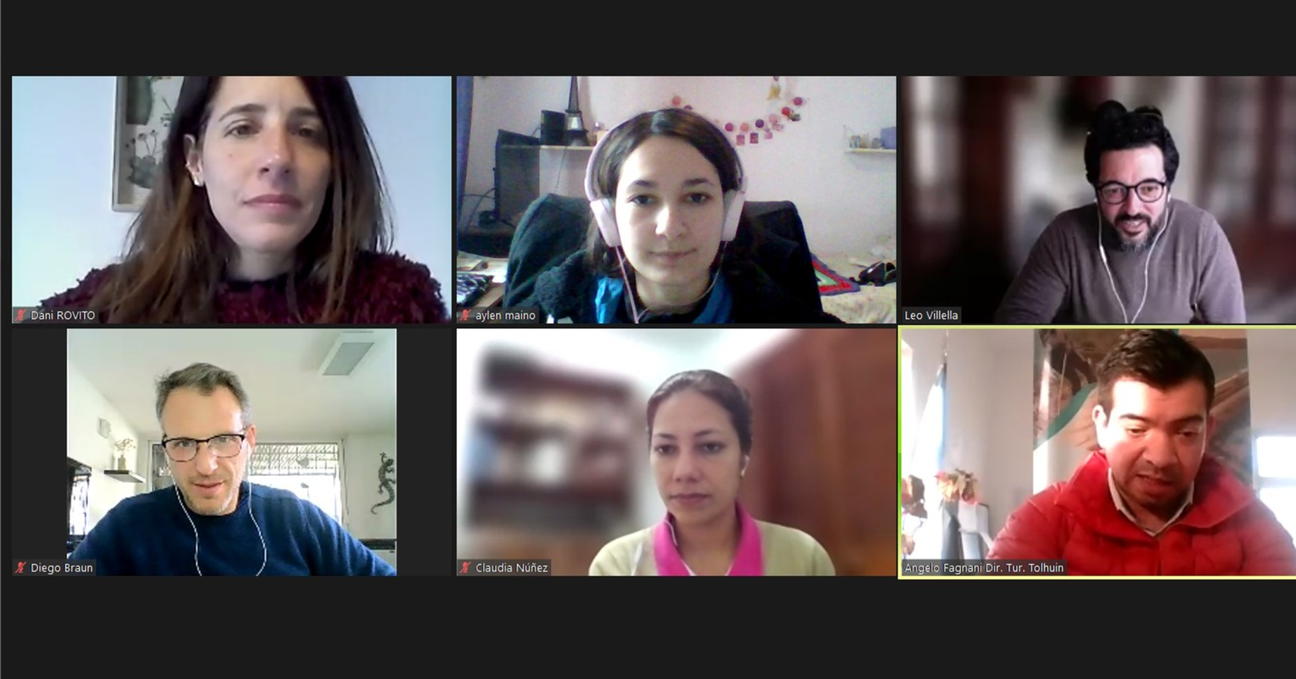
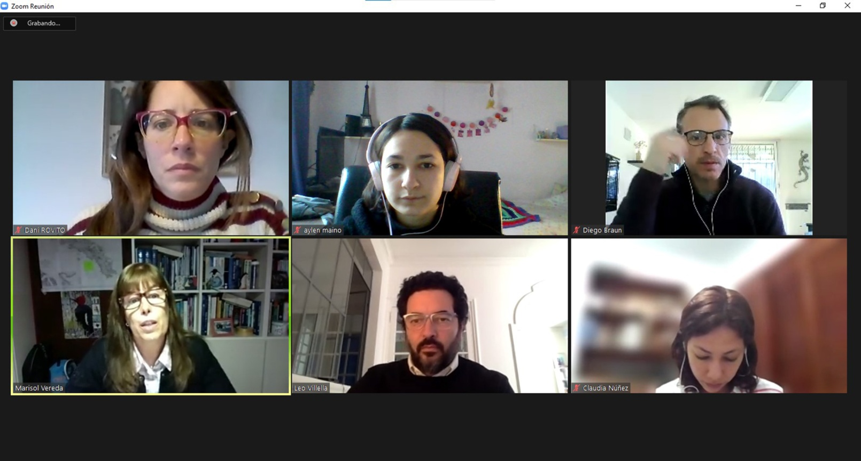
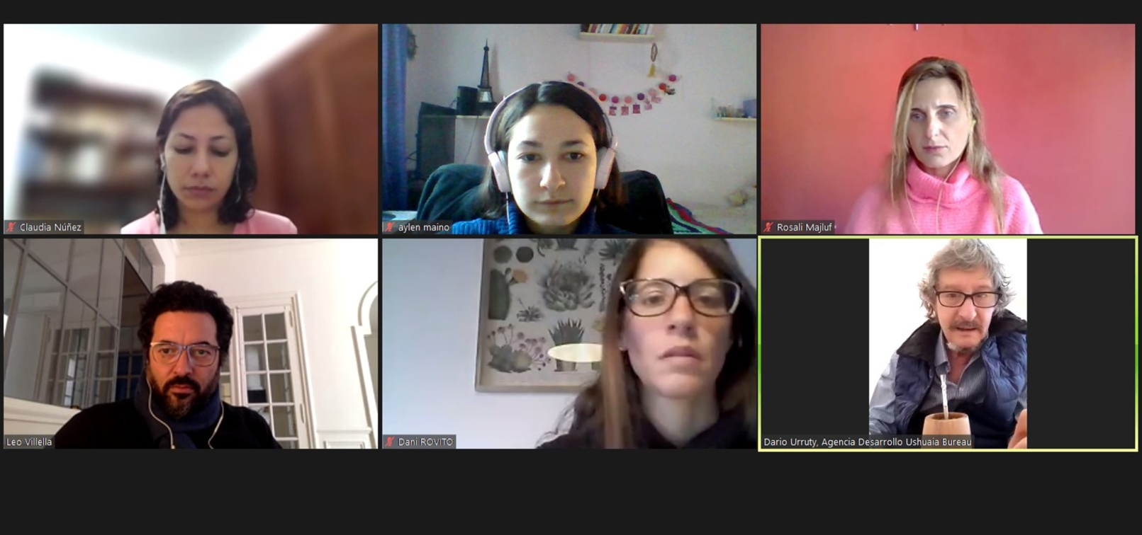
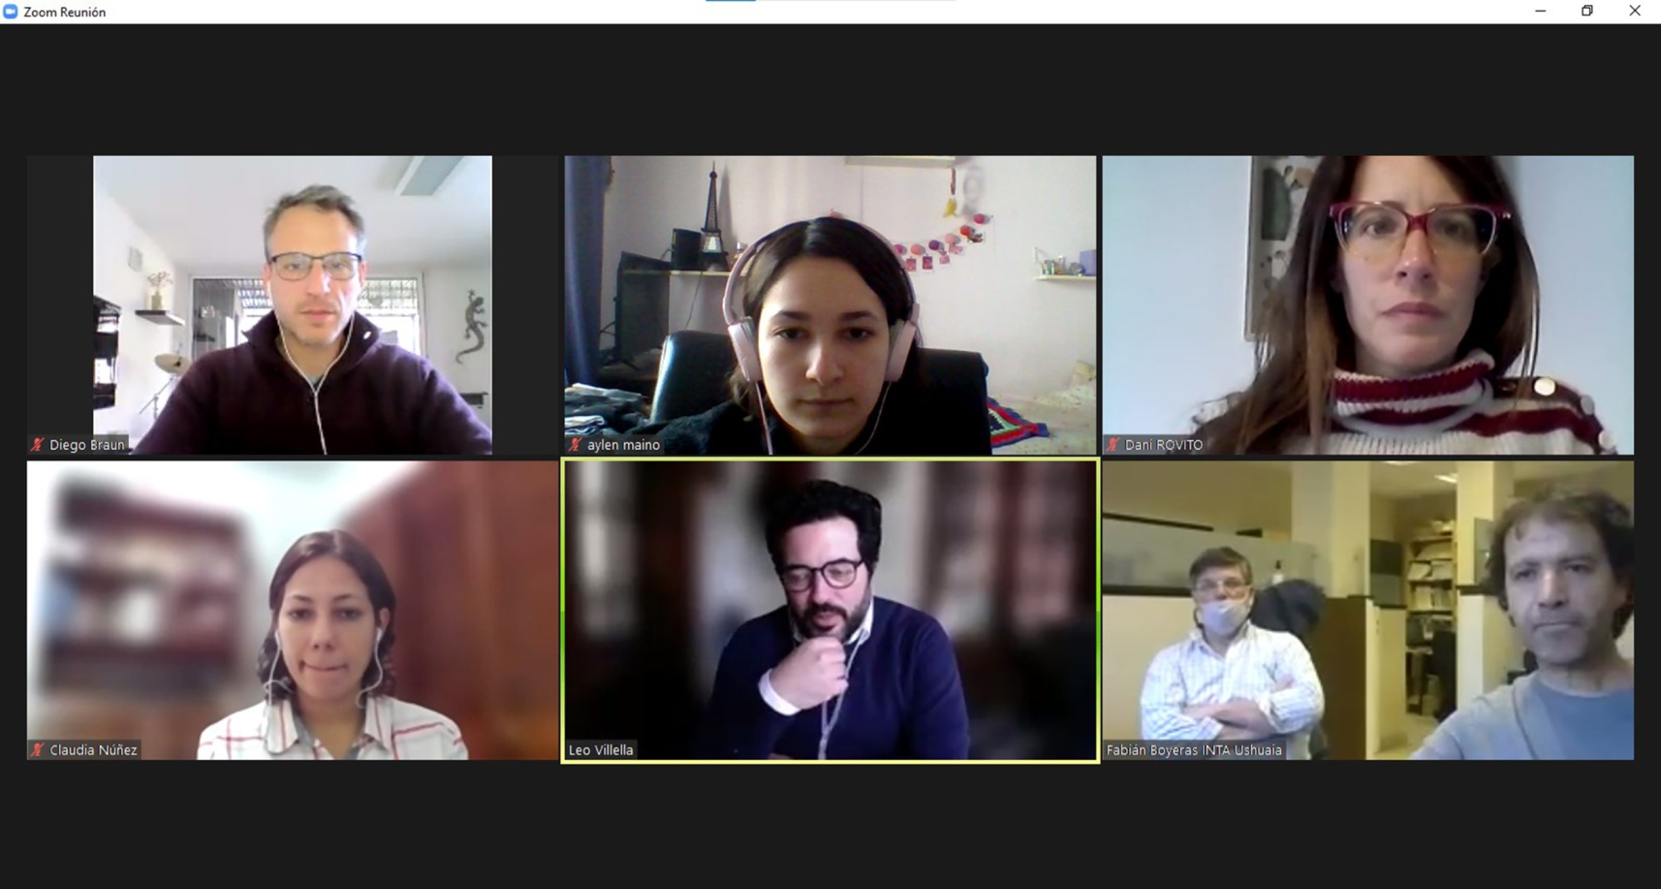
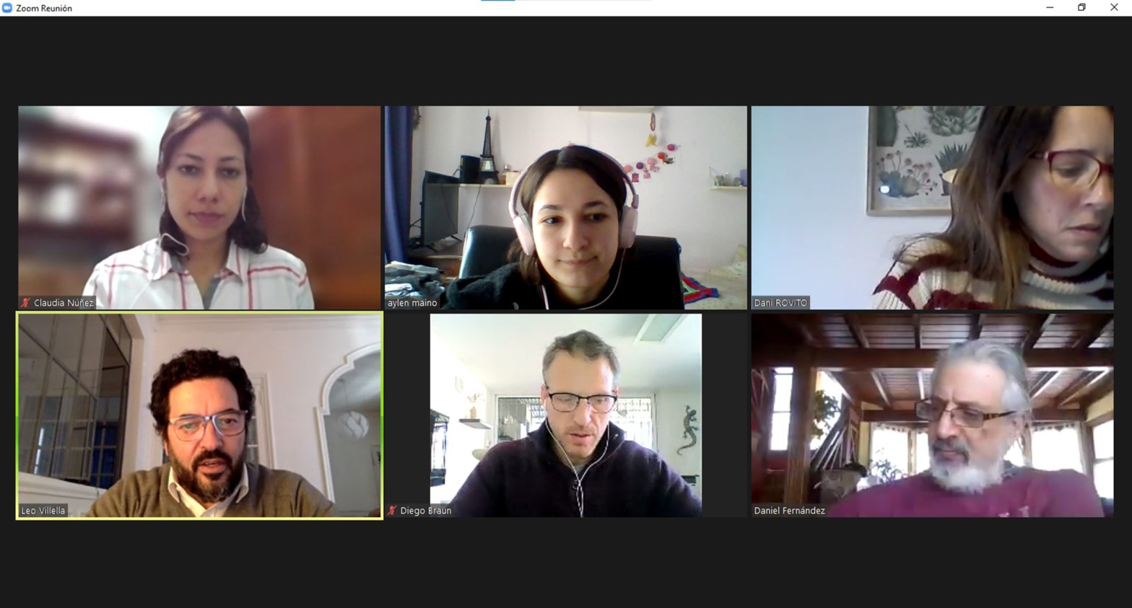
III. The approach
Phase 1 Stakeholder engagement
+ 30 individual consultations with
key stakeholders, private & public sector

Slide 16
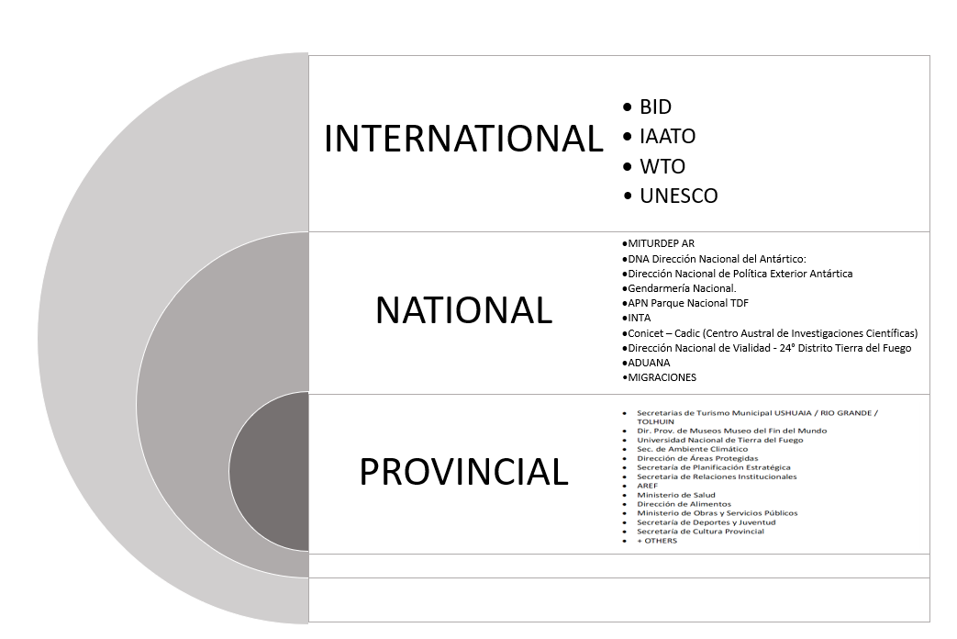
Phase 1: STAKEHOLDER ANALYSIS
III. The approach

Slide 17
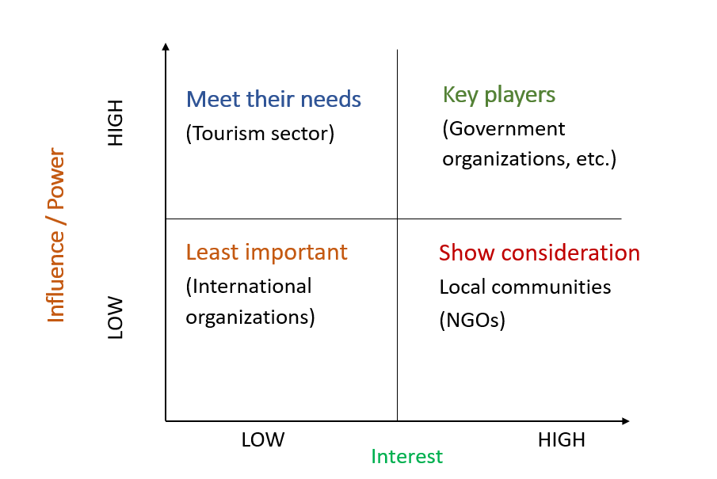
Phase 1: STAKEHOLDER ANALYSIS
III. The approach
The Stakeholder Mapping: Power /Interest Matrix

Slide 18
Phase 1: SWOT analysis
III. The approach
SWOT
STRENGTHS
WEAKNESSES
OPORTUNITIES
THREATS

Slide 19
Phase 1: Tourism Destination Audits
3. The approach
DESTINATION IMAGE & FACTS
RIO GRANDE
TOLHUIN
PUERTO ALMANZA
USHUAIA
FACTS
Renewable Energy
Water & Sanitation
Waste management
Protected Areas
Environmental issues
Accessibility
Mobility
Existing narrative – tourism development – products & infrastructure

Slide 20
Phases 2 & 3: Workshops – for proposal & validation
III. The approach
SWOT analysis
Destination audits
3 Rio Grande
3 Tolhuin
4 Puerto Almanza
3 Ushuaia
Public organizations & local tourism stakeholders
2 INFUETUR
3 Antarctic Tourism
DMO staff
Provincial and national organizations

Slide 21
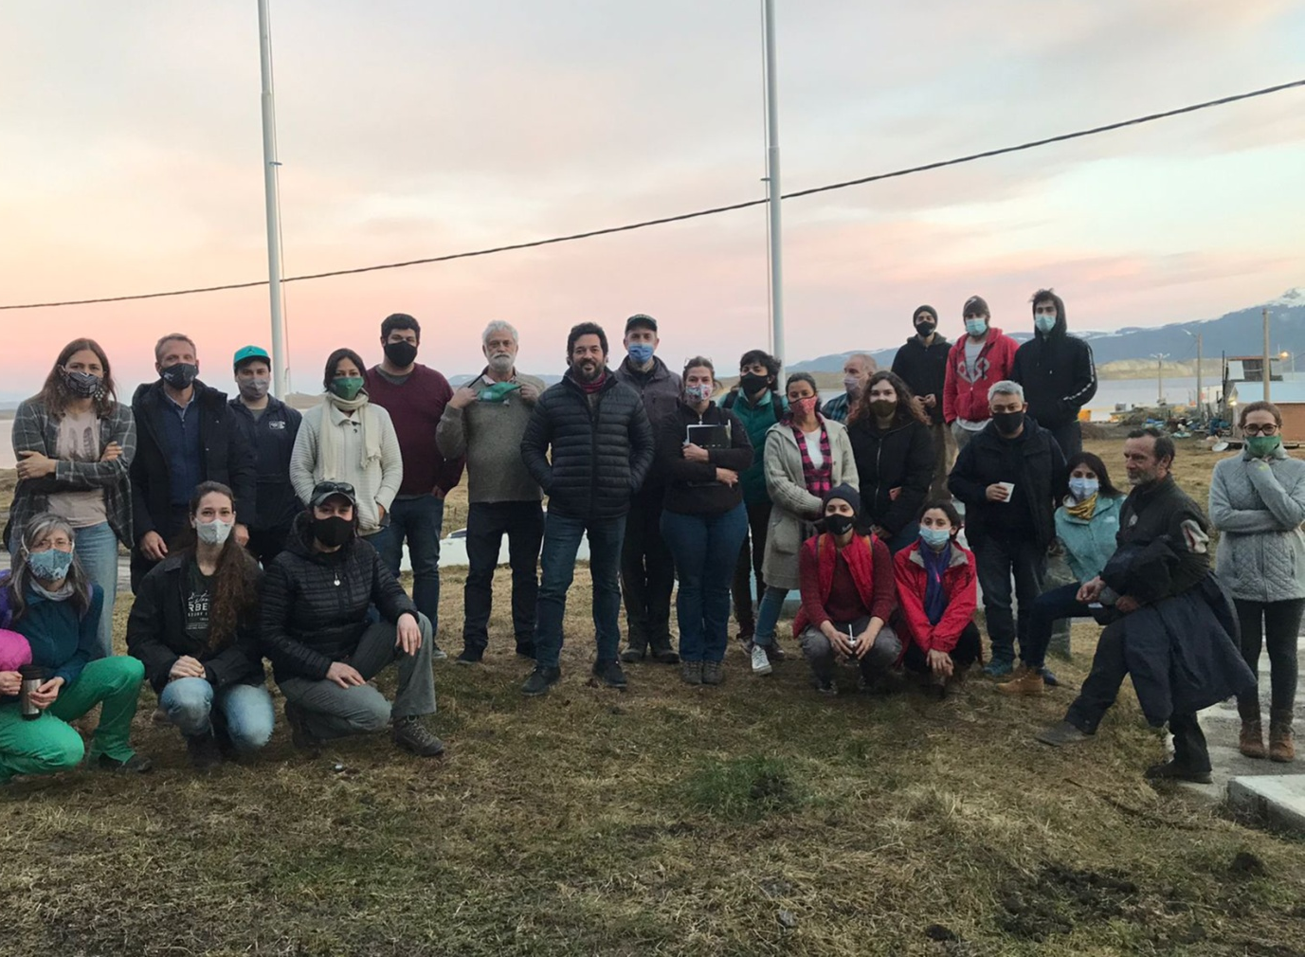
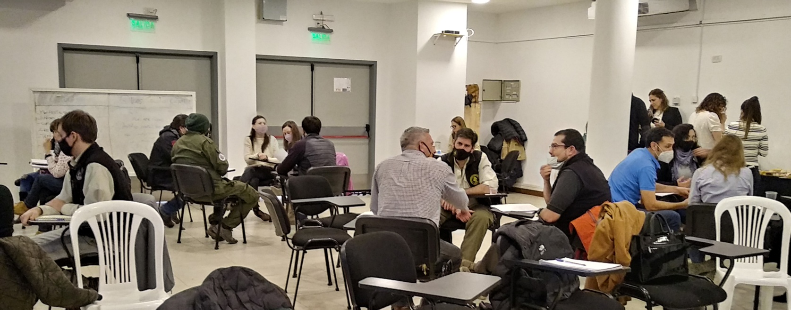
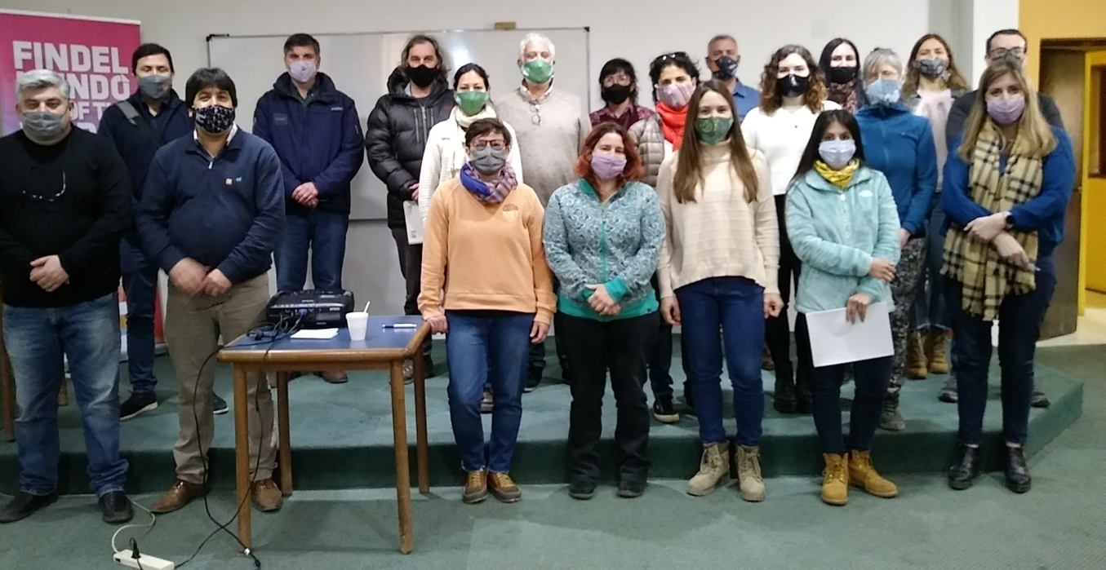
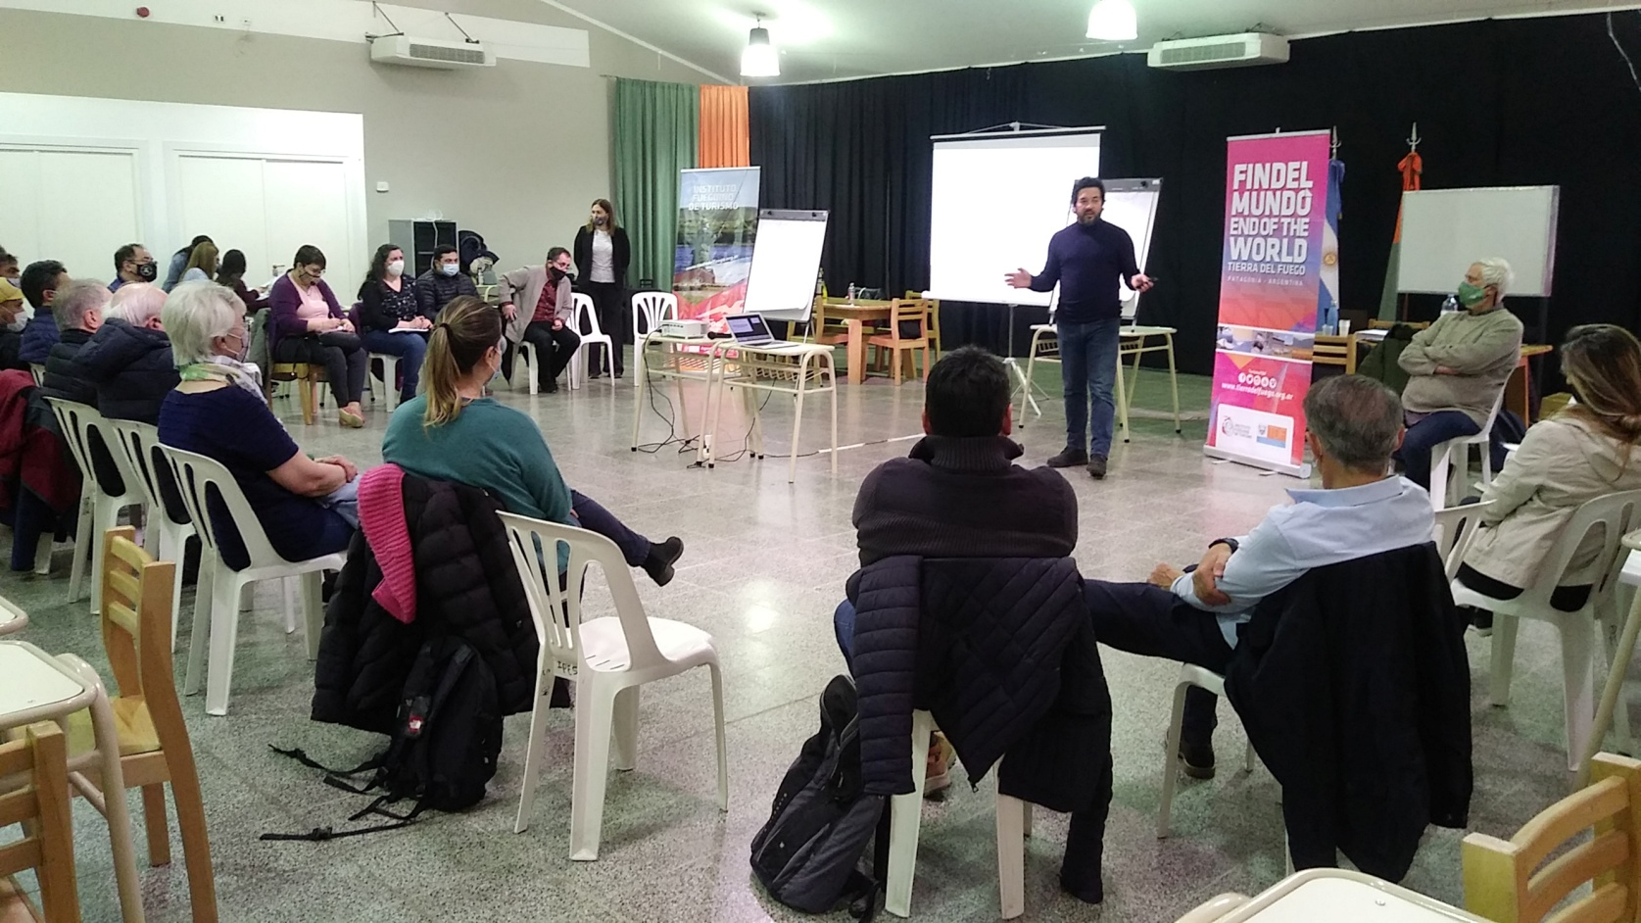
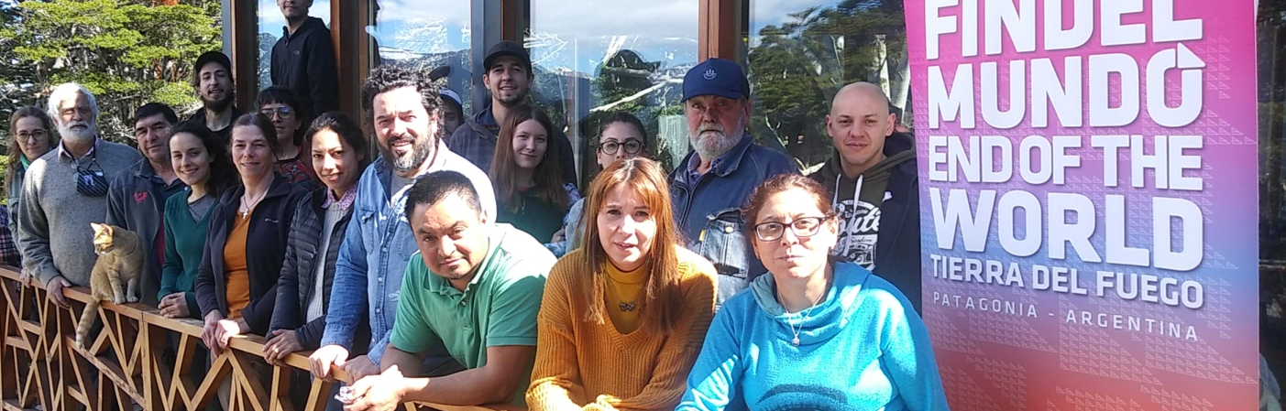
III. The approach
Phases 2 & 3: Workshops – for Proposal & validation
Stakeholder workshops:
private & public organizations

Slide 22
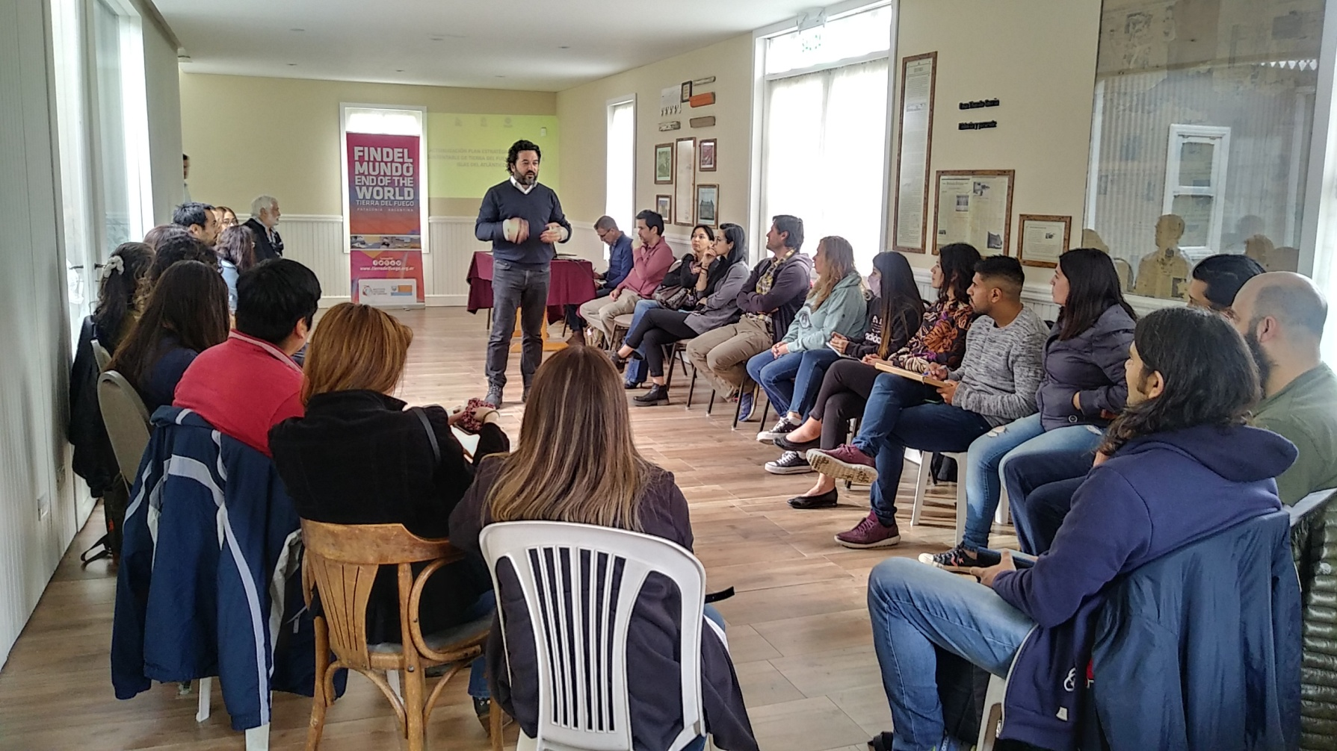
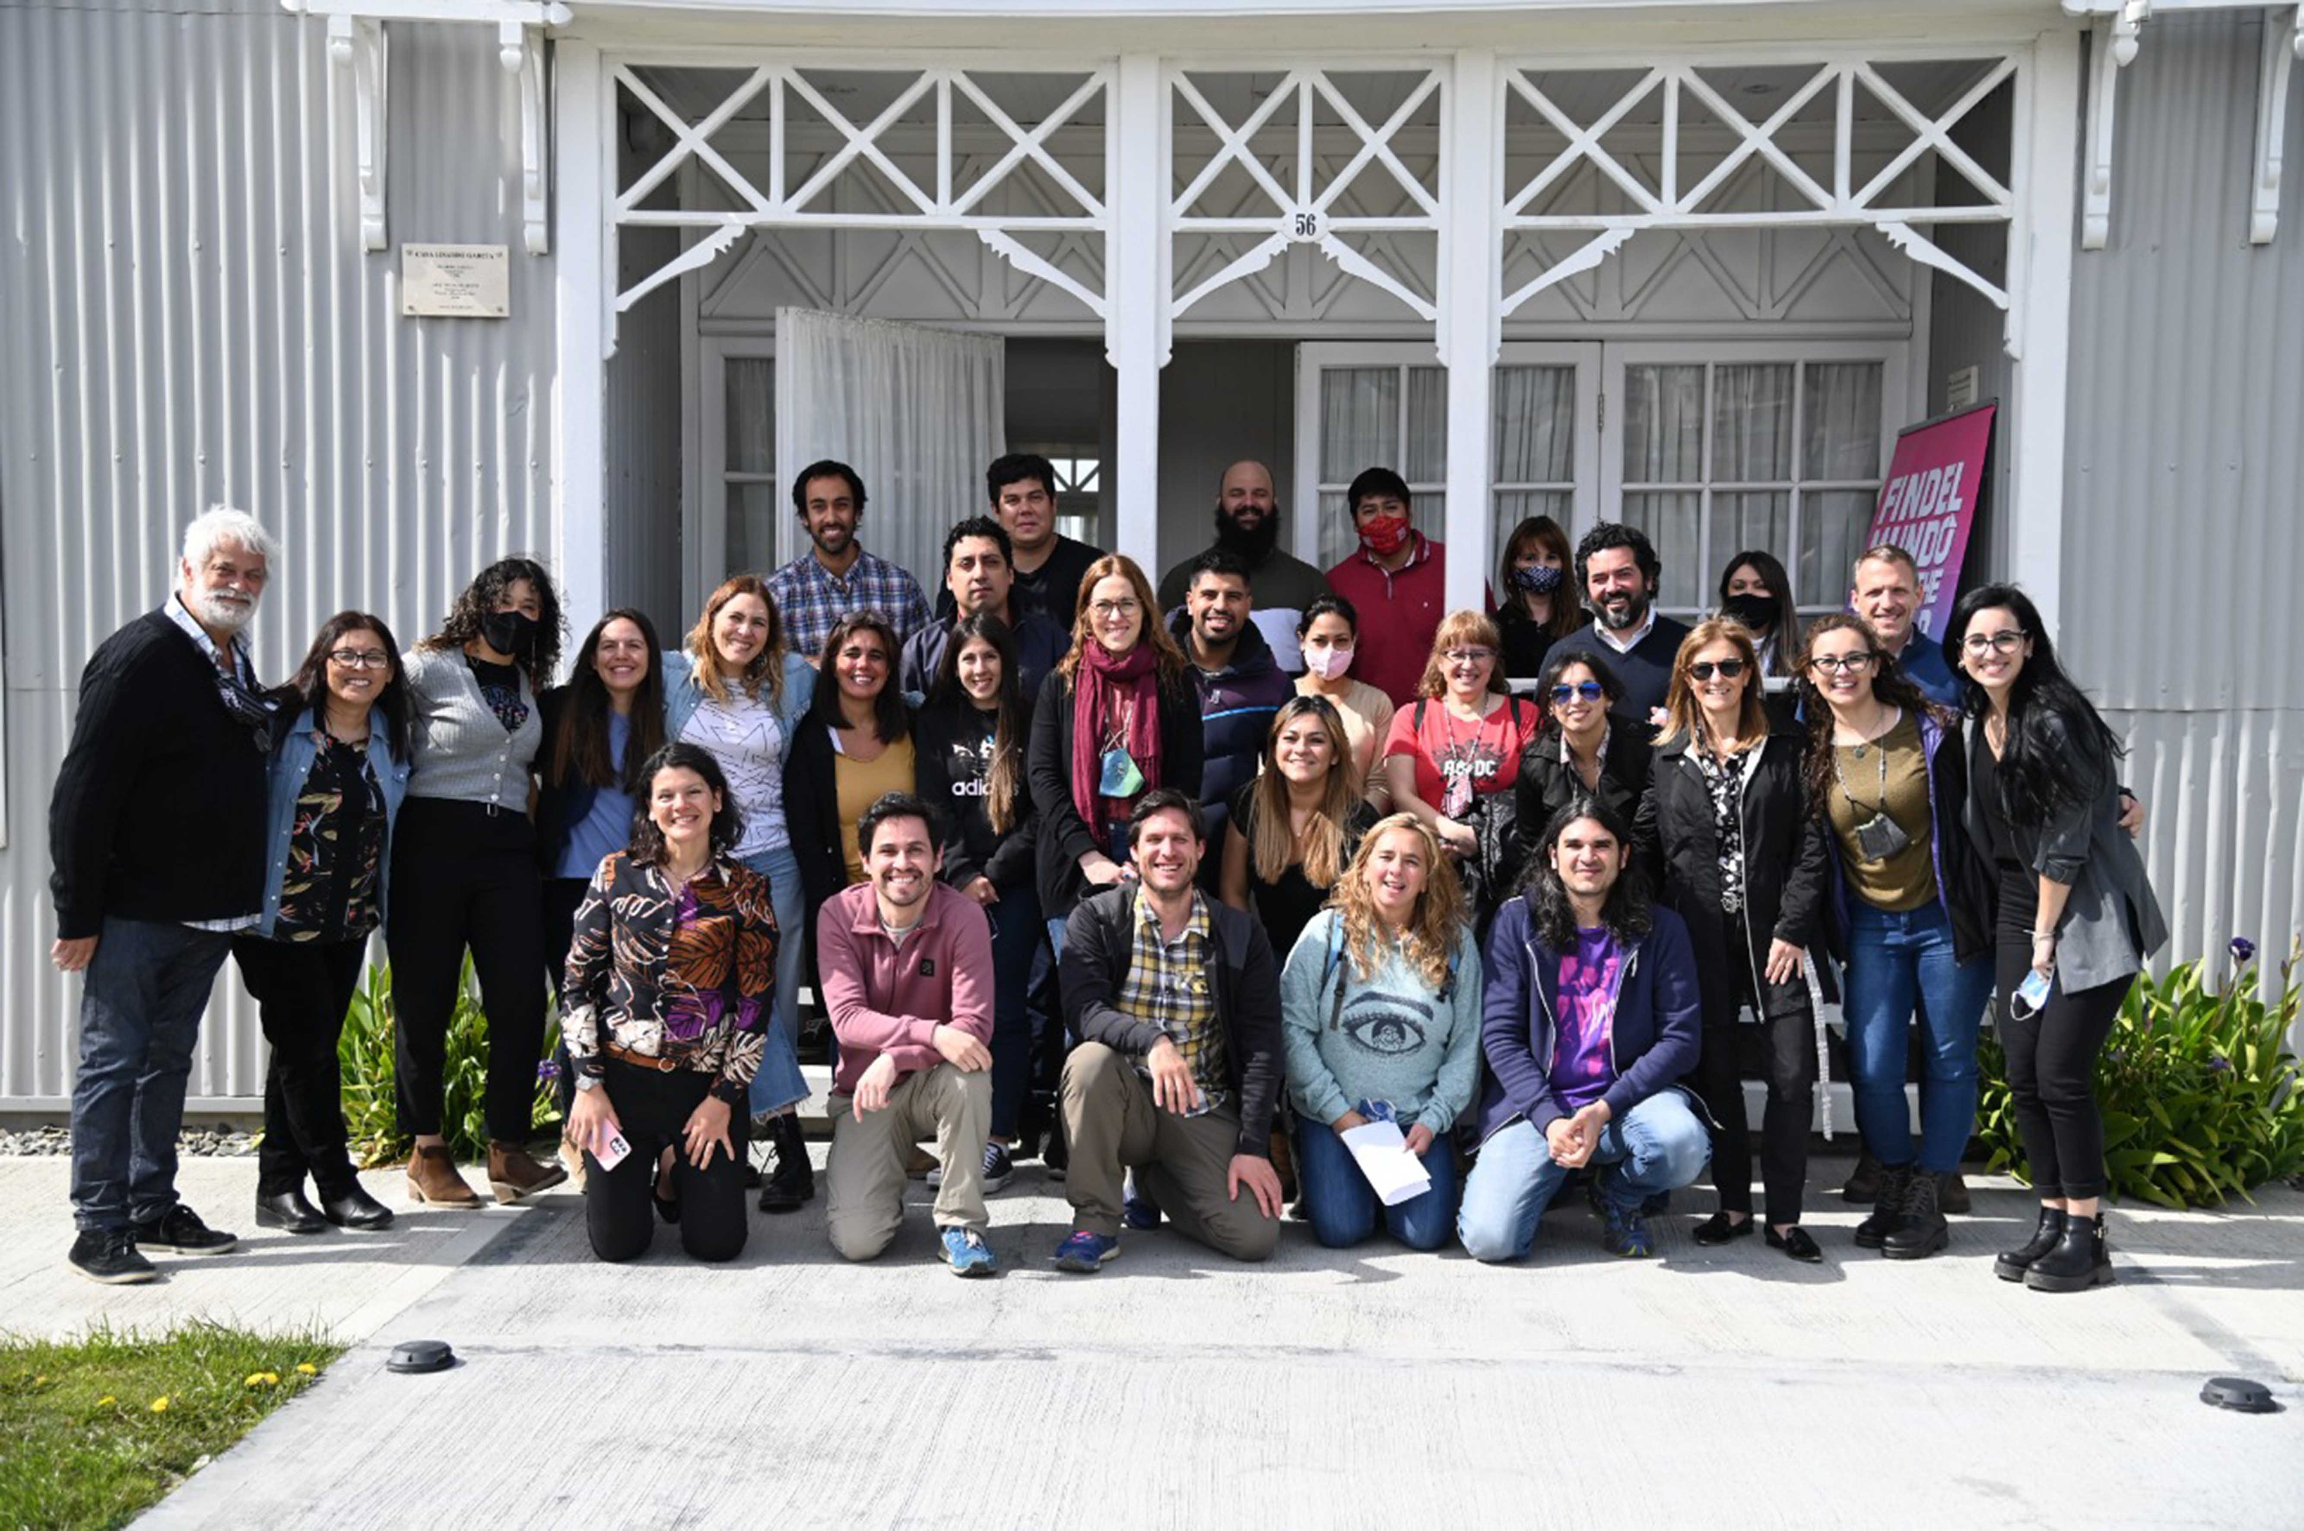
III. The approach
Phases 2 & 3: Workshops – for proposal & validation
DMO staff engagement workshops

Slide 23
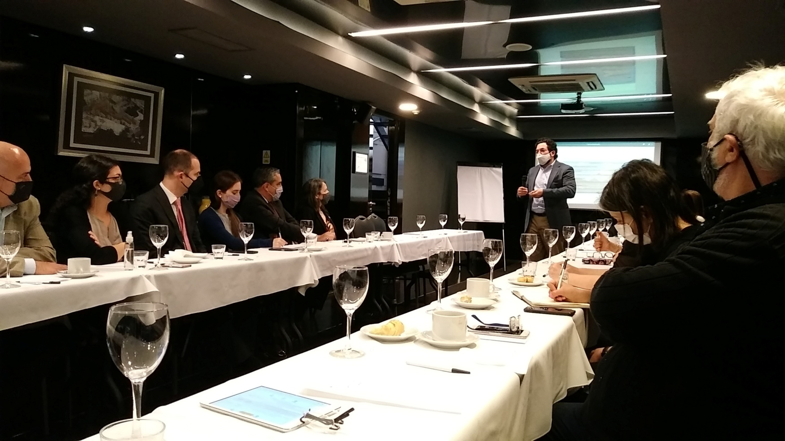
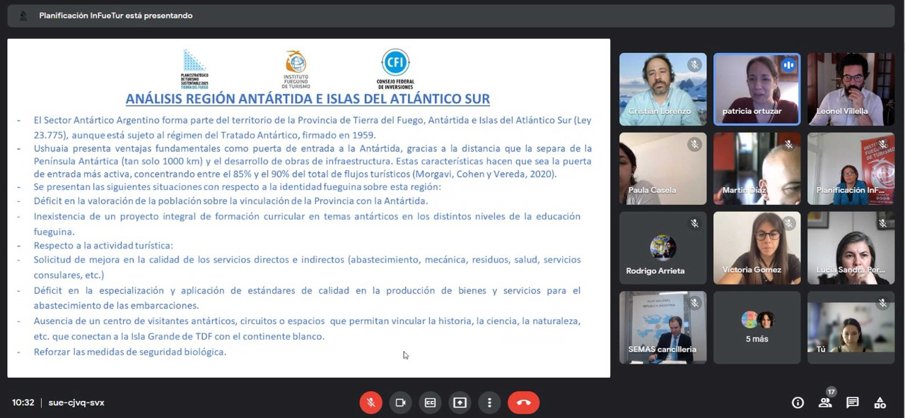
III. The approach
Antarctic Tourism Workshops
Phases 2 & 3: Workshops – for proposal & validation
Provincial organizations
2 Provincial & National agencies
In Ushuaia & Buenos Aires

Slide 24

IV. The outcome
The Plan
5 Strategic Pillars
13 Programs
49 Projects
+200 Actions

Slide 25
IV. The outcome
The Plan 5 Strategic Pillars
1. The tourist experience (product)
2. Relationship with tourism sector
3. DMO management & stakeholder engagement
4. Integrated planning & collaboration
5. Tourism Intelligence

Slide 26
IV. The outcome
Programs, Projects and Strategic Actions
Antarctic Tourism
STRATEGIC ACTIONS
PILLAR 1
The tourist experience (product)
PROGRAM 1.2 Tourism infrastructure
Development of the executive project & other projects connected to the Antarctic Visitor Center
PROJECT 1.2.1 Touristic projects of interest
To develop the Antarctic logistics center
To set up & update HR database
To optimize local services (waste, food supply, health services, consular assistance)
PROJECT
1.3.1 Local development & HR
PROGRAM 1.3 Competitiveness (Antarctic tourism products)
PROJECT 1.3.2 Antarctic tourism management
To develop a complementary offer
To update the website with info of Antarctic tour operators

Slide 27
Programs, Projects and Strategic Actions
IV. The outcome
Antarctic Tourism
STRATEGIC ACTIONS
PILLAR 2
Relationship with the tourism sector
PROGRAM 2.1 Continue improvement
PROJECT 2.1.2 Develop understanding in the public sector
Staff training in key areas (borders, ports, airports)
Staff training in Antarctic Treaty protocols

Slide 28
Programs, Projects and Strategic Actions
IV. The outcome
Antarctic Tourism
PILLAR 3
DMO management & stakeholder engagement
STRATEGIC ACTIONS
PROGRAM 3.1 Improve the institutional programs within INFUETUR
PROJECT 3.1.4 Human capital development
Collaboration with academic institutions for training in Antarctic topics

Slide 29
Programs, Projects and Strategic Actions
IV. The outcome
Antarctic Tourism
STRATEGIC ACTIONS
PILLAR 4
Integrated planning & collaboration
To develop and coordinate an inter-institutional discussion for development of Antarctic tourism
To define narrative of national Antarctic history, develop content and share
To improve environmental mgmt.
To optimize local supply
PROGRAM 4.1
Inter-institutional collaboration (national, provincial, local)
PROJECT 4.1.1 Cooperation with Antarctic Tourism

Slide 30
IV. The outcome
Programs, Projects and Strategic Actions
Antarctic Tourism
STRATEGIC ACTIONS
PILLAR 5
Tourism Intelligence
PROGRAM 5.2 Strategic information
PROJECT 5.2.1 Statistics and data
To compile and release seasonal reports about Antarctic expeditions

Slide 31
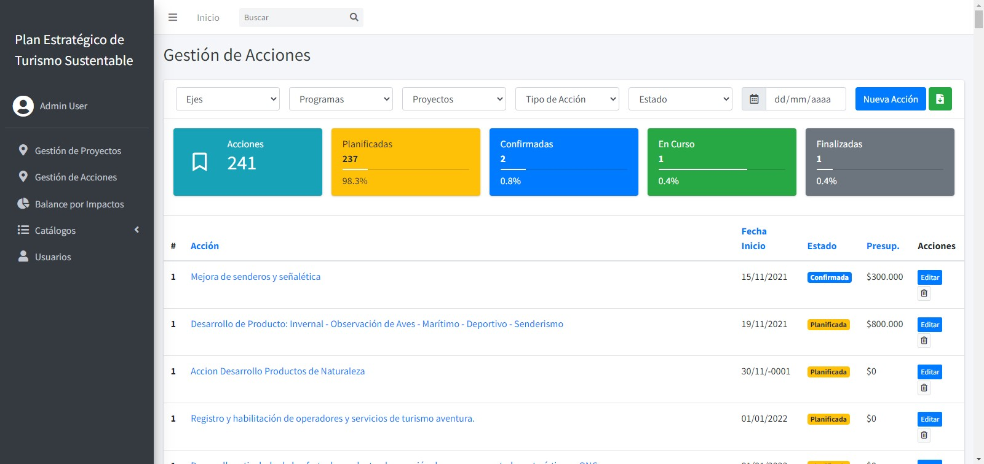
IV. The outcome
System for carrying out the Plan

Slide 32
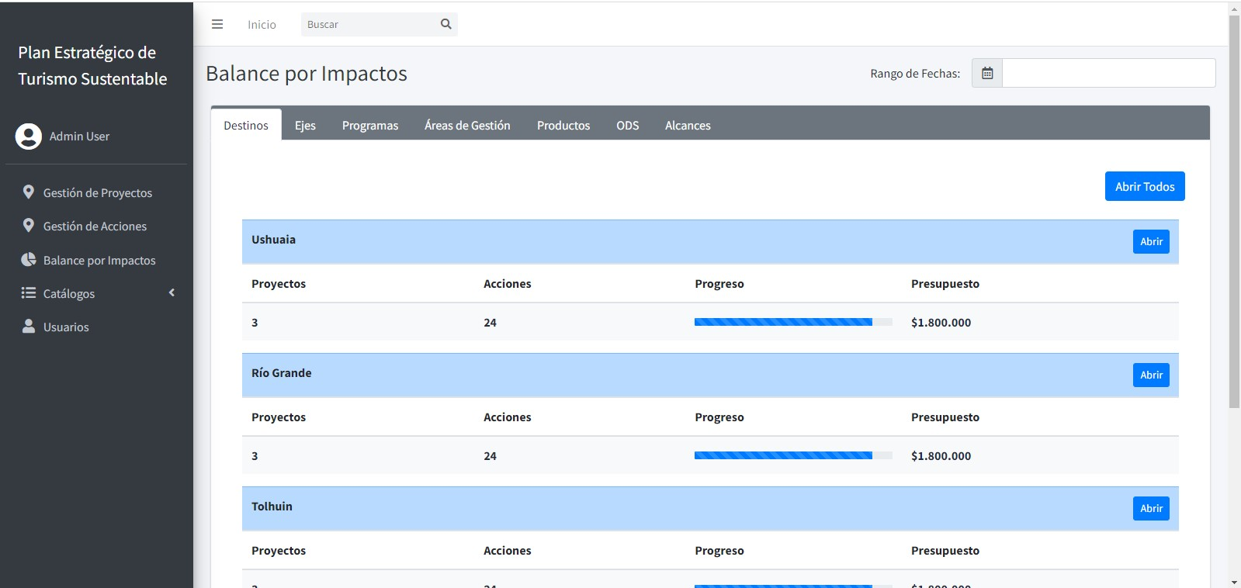
IV. The outcome
Communication Plan for the strategic plan

Slide 33
IV. The outcome
Conclusion
The plan is the result of comprehensive research, community engagement, stakeholder outreach and collaboration with DMO team members
The Plan sets a direction for the Province, identifies future potential growth and recognizes the opportunity the DMO has to harness and manage the growth for the benefit of the community and visitors.
Working together with the many government agencies, organizations, community and stakeholders is key for success.
TIERRA DEL FUEGO
SUSTAINABLE TOURISM STRATEGIC PLAN 2025

Slide 34
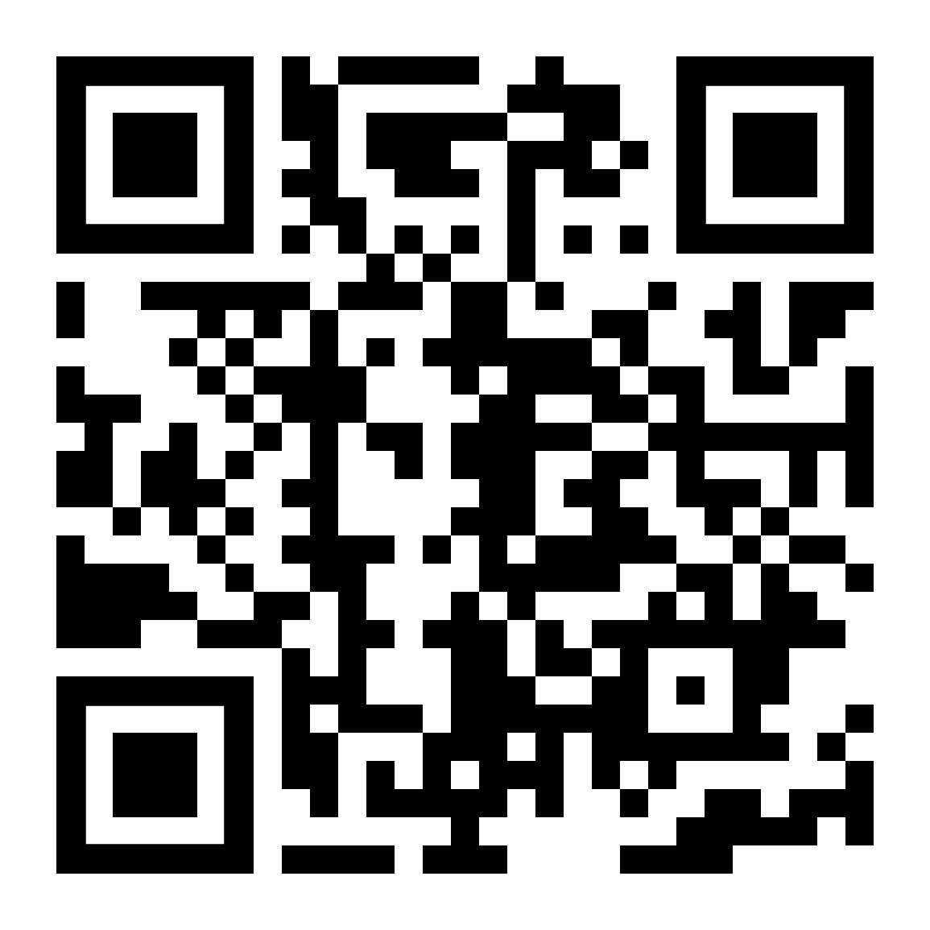
IV. The outcome
The final document
https://infuetur.gob.ar/plan_estrategico
Available in Spanish only
https://findelmundo.tur.ar/es

Slide 35
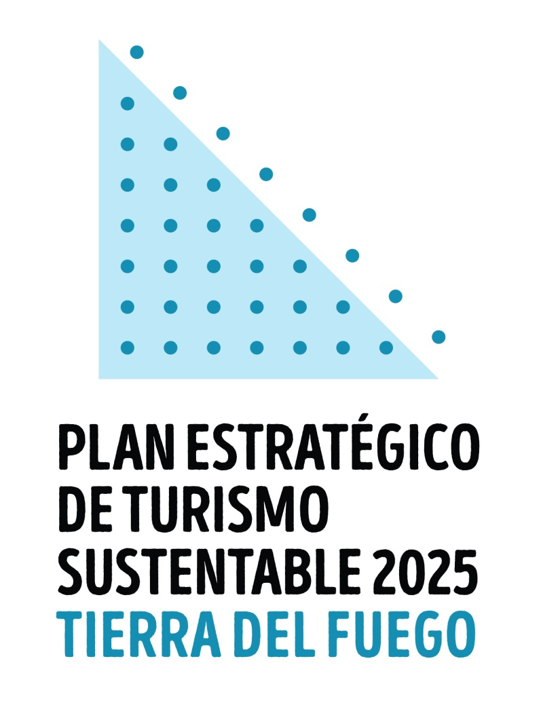

THANK YOU

